Slide 1
SC1015
Mini
Project
SC20 Group 4
Xavier Yeo (U2120239E)
Chiam Da Jie (U2121233G)
Zack Zhang Hong Ming (U2120777L)
Notes:
Greetings everyone, today, group 4 will be presenting on the mini project for SC1015. The group consists of Xavier, Zack and myself

Slide 2
Dengue
Dengue causes a wide spectrum of disease and in some cases, lead to hospitalisation or death.
Each year, an estimated 390 million dengue infections occur around the world, resulting in up to 36,000 deaths.
How can we reduce the impacts?
Notes:
Dengue fever is a mosquito-borne disease that occurs in tropical and sub-tropical parts of the world. In mild cases, symptoms are similar to the flu: fever, rash, and muscle and joint pain. In severe cases, dengue fever can cause severe bleeding, low blood pressure, and even death. Because it is carried by mosquitoes, the transmission dynamics of dengue are related to climate variables such as temperature and precipitation
Each year, an estimated 390 million dengue infections occur around the world, resulting in up to 36,000 deaths.
How can we reduce the impacts of dengue fever?

Slide 3
Problem Definition
Data set: DrivenData - DengAI
Are we able to predict the total number of cases in a week based on the environmental and climate data of that week?
Which of our selected models would be the best to predict it?
Notes:
By using the data set provided by DrivenData-DengAI, our team aim to predict the total number of cases in a week based on the environmental and climate data of that week Which of our selected models would be the best to predict it?

Slide 4
BUT first, let’s explore the data
Notes:
But before we dive into the problem, lets explore the data set we found

Slide 5
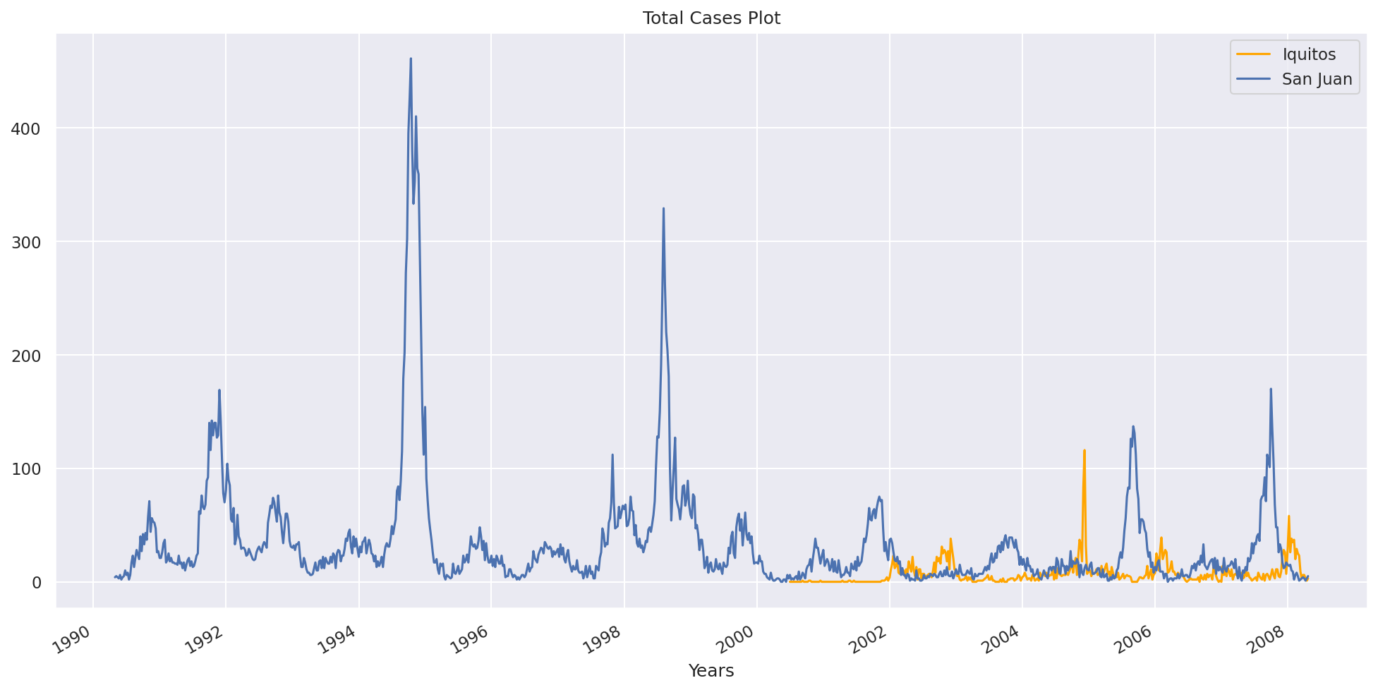
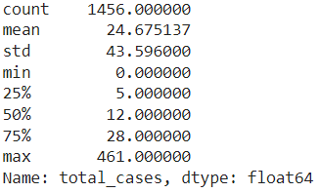
Total cases
Notes:
For the total cases which we will be predicting
We can observe the trend over the years
and the other properties such as the min max and median

Slide 6
Numerical Data
Normalised Difference Vegetation Index (NDVI)
More vegetation, more cases?
Temperature
Warmer temperature, more cases?
Precipitation
More rainfall, more cases?
Humidity
Higher humidity, more cases?
Notes:
Moving on to the variables provided to predict the total cases, for the numerical data
They can be split into 4 main groups: ndvi, temp, precipitation and humidity
Looking at these groups, some relationships popped into our heads and it seemed as though they would all have a strong linear correlation

Slide 7
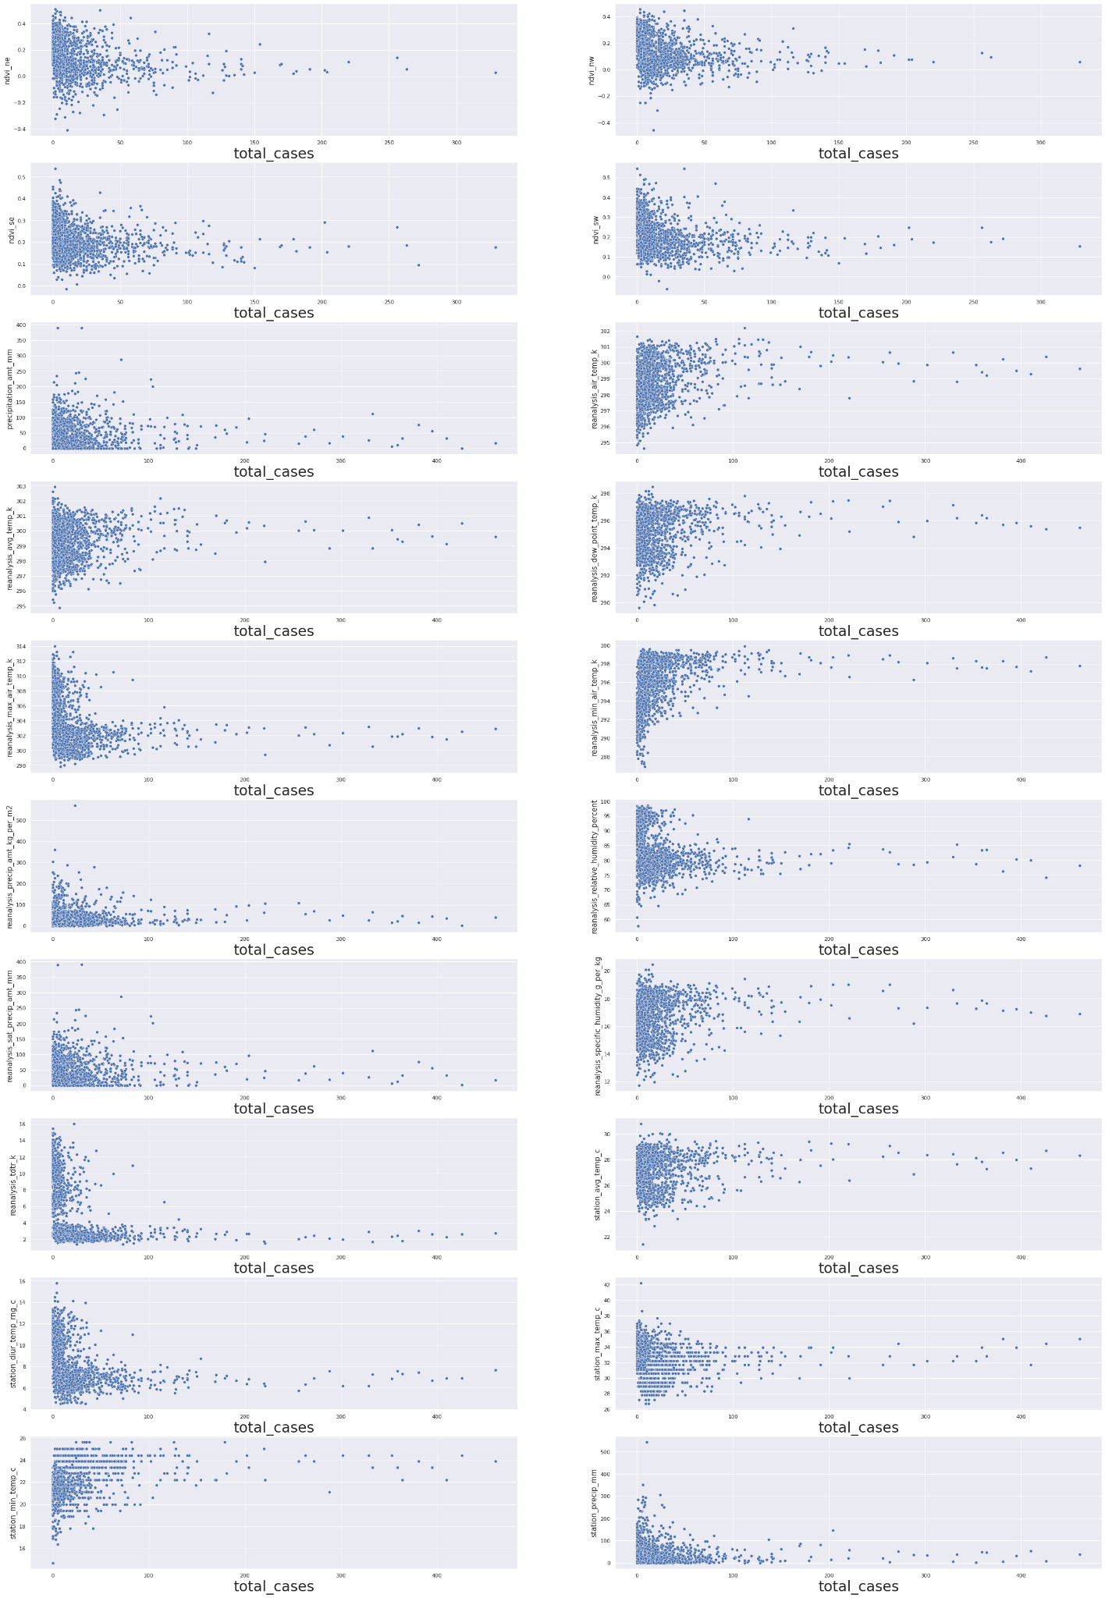
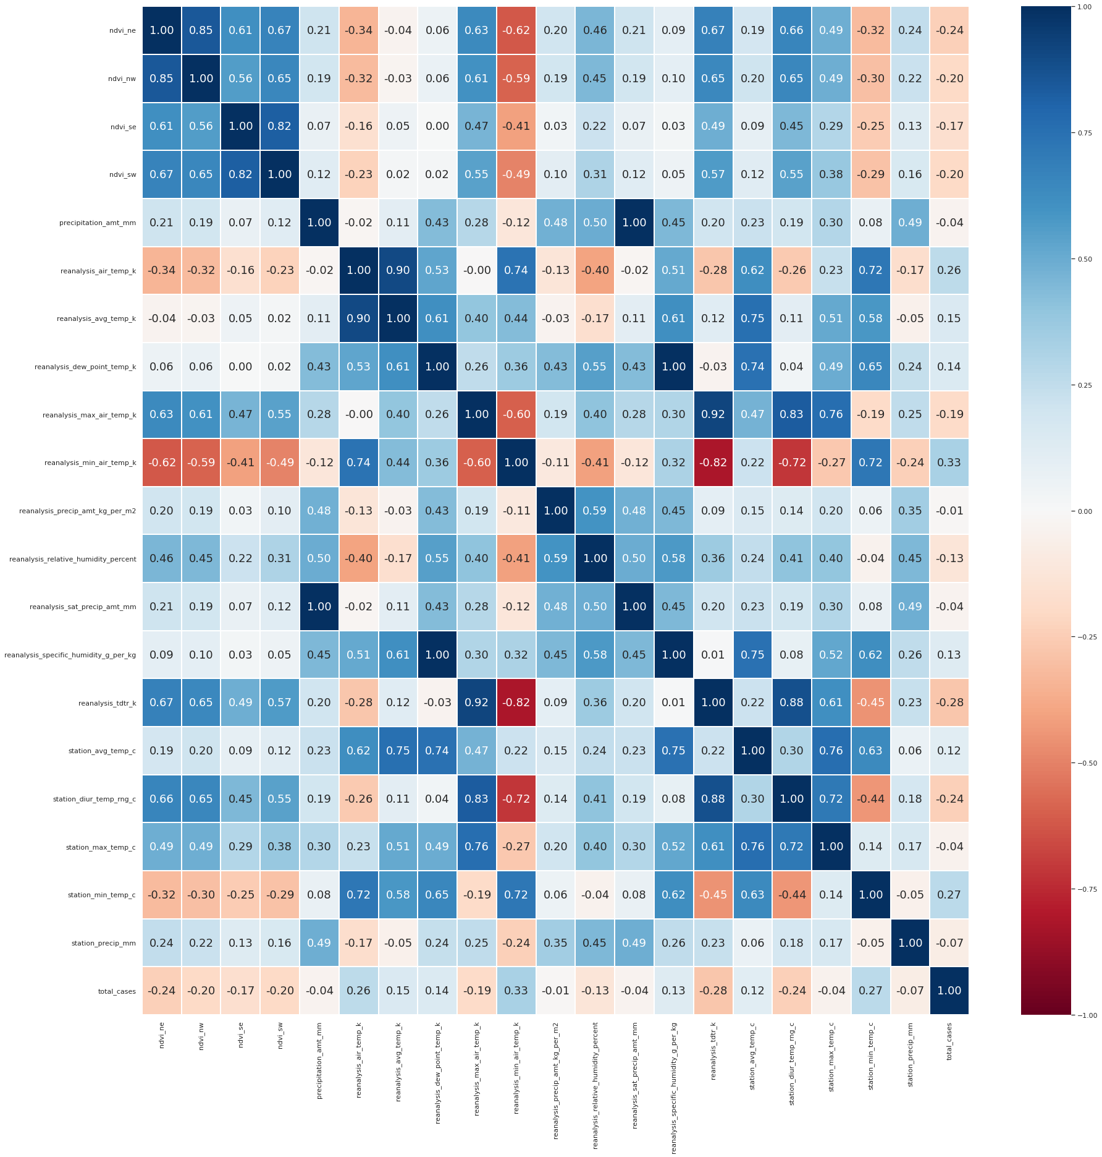
Numerical Data
Notes:
But when we took a look at the scatter plot of the variables against total cases and the correlation matrix
We realised that it was not the case

Slide 8
Numerical Data
Surprisingly, the correlation between the variables and total cases are mostly quite low and our predictions of the relationships were not very accurate.
Notes:
We found that the correlations were actually mostly quite low, with reanalysis min air temp having the highest correlation of 0.33
So our predictions were not very accurate as they do not have strong linear relationship as we expected.
However, it is possible that they have non-linear relationship and thus, we decided to explore non-linear models as well

Slide 9
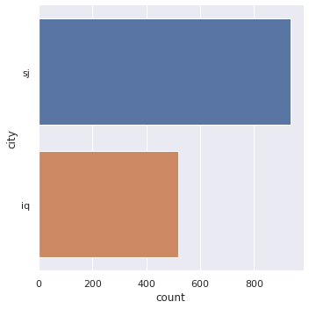
Categorical Data
The data is split into 2 cities: San Juan (sj) and Iquitos (iq)
With sj having around twice the number of entries as iq
Notes:
Moving onto the categorical data, there was only 1 variable, the city
The data is split into 2 cities san juan and iquitos, with san juan having around twice the amount of data compared to iquitos

Slide 10
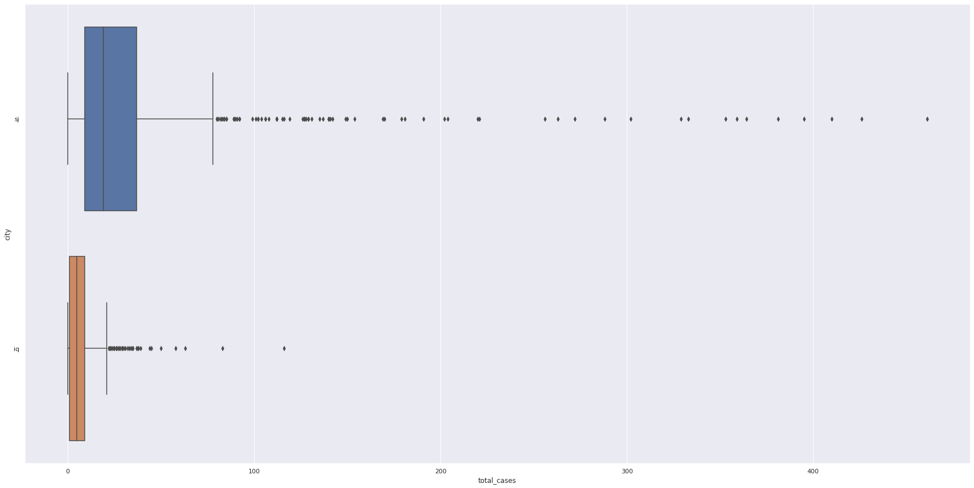
Categorical Data
The box plots are generally quite close to one another, thus the cities may not be reliable as a predictor
Notes:
After observing the box-plot of the 2 cities, we realised they were quite close and thus may not be good variables to use

Slide 11
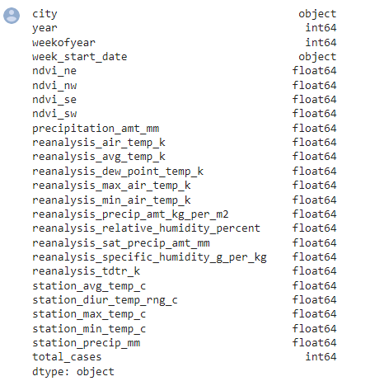
Data Cleaning
Notes:
Next, we will be moving on to the data cleaning part of our mini project.
The cleaned dataset will then be used as train and test datasets for our machine learning part of the project.
Let us first take a look at all the variables in the original dataset.
Since our problem is trying to predict the total number of dengue cases in a week based on the environmental and climate data.
The city variable doesn’t really matter in this case, as we are not trying to predict the total number of dengue cases in each different cities, hence we can remove the city variabel from our dataset.
Next, Time series data are also not necessary as they are not environmental-related data.
Hence, we will be removing the ‘year’, ‘weekofyear’ and ‘week_start_date’ column.
Next, for environment factors such as average temperature, Diurnal temperature range, maximum temperature, minimum temperature and total precipitation,
We can see that there is more than 1 variable representing each factors.
For example, for average temperature of the week, there are station average temperature and reanalysis average temperature.
Both variables represent the average temperature of the week, as they are based on the same set of data collected in the field.
Our group decides to use reanalysis data instead of station data, this is because reanalysis data minimises off the measurement errors from the instruments.Hence, making the values in the columns a more accurate representation of the actual data.
As such, we decide to drop the all the station variables.
Lastly, there are a few variables related to temperature of the week, we decide to remove the reanalysis maximum air temperature and reanalysis minimum air temperature columns.
As we feel that reanalysis average air temperature and reanalysis mean air temperature are better representation of the temperature of the week.

Slide 12
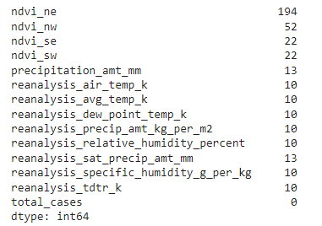
Data Cleaning - Null Values
Notes:
Since we know that there are null values in the data, let's find out more and decide how to handle the null values.
Checking if there are any null values in columns and if so, the sum of the null values in each column.
From this information, we can see that "ndvi_ne" has a large amount of null values, almost 200, while the others only have a relatively small number
However, the number of null values of "ndvi_ne" is at an acceptable range at around 13%. Thus, we can fill in the missing values.

Slide 13
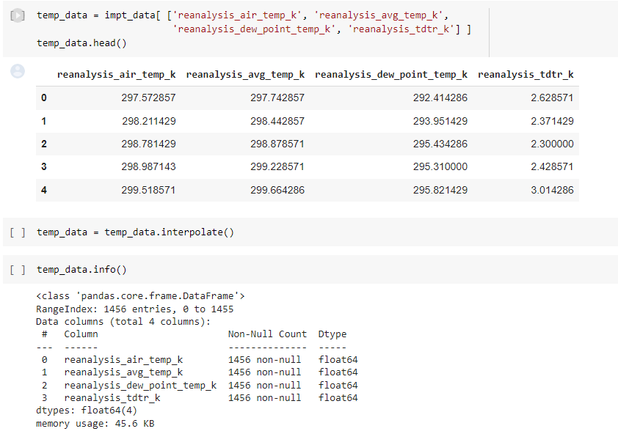
Temperature Variables
Notes:
For the temperature variables, we will use the interpolation method to fill in the values.
This is as the data ranges across the weeks of the year and different months would have different range of temperatures. Thus, it would be more apt to use that instead of the mean or median of the temp over the whole period of time.

Slide 14
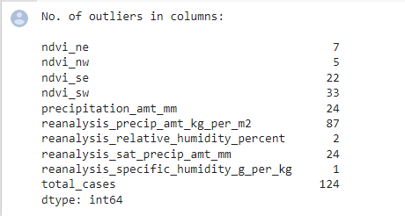
Other Variables
Notes:
Finding the number of outliers for the different columns to determine if mean or median more appropriate to be used to fill in the other null values.
Since there are quite a few outliers in the columns, we will use median to fill the null values.
We then concatenate temperature variables with these variables to form our cleaned datasets.

Slide 15
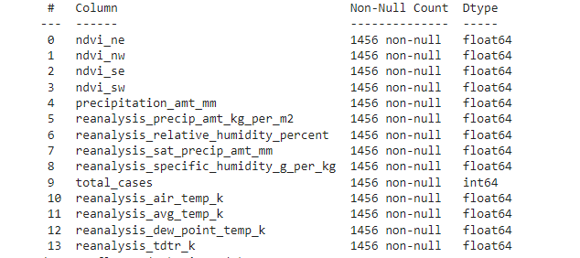
Cleaned Dataset
Notes:
Finding the number of outliers for the different columns to determine if mean or median more appropriate to be used to fill in the other null values.
Since there are quite a few outliers in the columns, we will use median to fill the null values.
We then concatenate temperature variables with these variables to form our cleaned datasets.

Slide 16
Machine Learning
Regression Analysis used to determine the relationship between total cases and multiple independent (predictor) variables.
The analysis yields a predicted value for the total cases.
Notes:
Since we are predicting the total number of dengue cases per week, this is a regression problem.
The regression analysis..

Slide 17
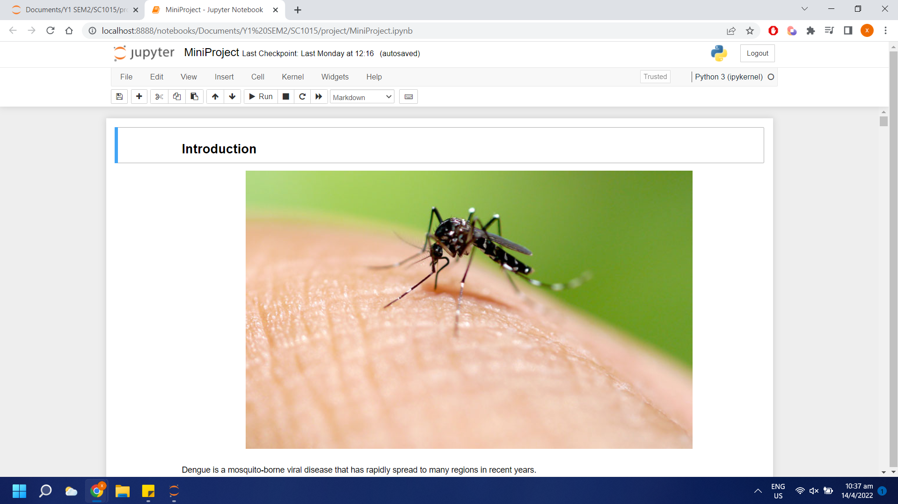
Machine Learning
Regression Analysis using:
Linear Regression
Support Vector Machine
K-Nearest Neighbours
Metric used: Mean Absolute Error (MAE)
Notes:
Here are the 3 machine learning model that we will be using,
As suggested by the existing problem, we will be using mean absolute error for measuring the goodness of fit of the linear regression model.

Slide 18
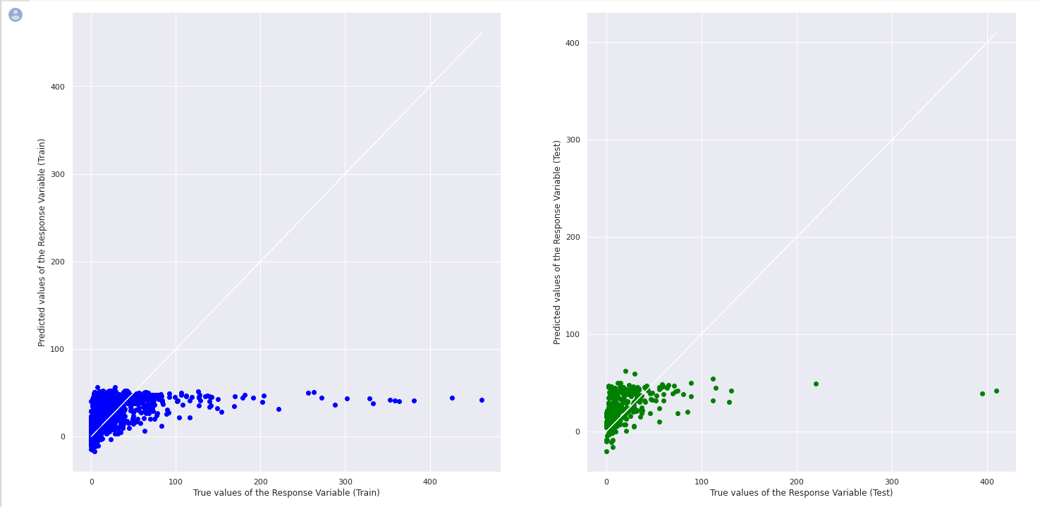
Prediction with Multiple Variables
Notes:
Here’s the Visualization of the linear regression model on train and test set.
Next, Xavier will talk about the Support Vector Machine Model

Slide 19
Linear Regression
Mean Absolute Error (MAE) on Test Set
19.05618487684523
Notes:
First, we used the linear regression model.
By applying what we learned about linear regression, We used a prediction with multiple variables approach for our linear regression model.
This is the resulting values that we get,

Slide 20
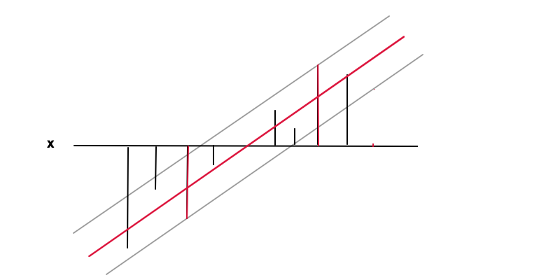
Support Vector Machine (SVM)
How does SVM work for regression?

Slide 21

Support Vector Machine (SVM)
The more common kernels for SVM are ‘rbf’, ‘linear’ and ‘poly’.
So, we used K-Fold cross validation to compare the 3 different kernels, after doing feature scaling.

Slide 22
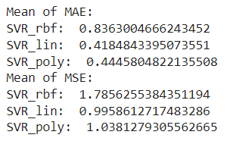

Support Vector Machine (SVM)
‘linear’ had the lowest MAE and MSE
Thus, we decided on the linear kernel for our SVM model.
Using the ‘linear’ kernel,

Slide 23
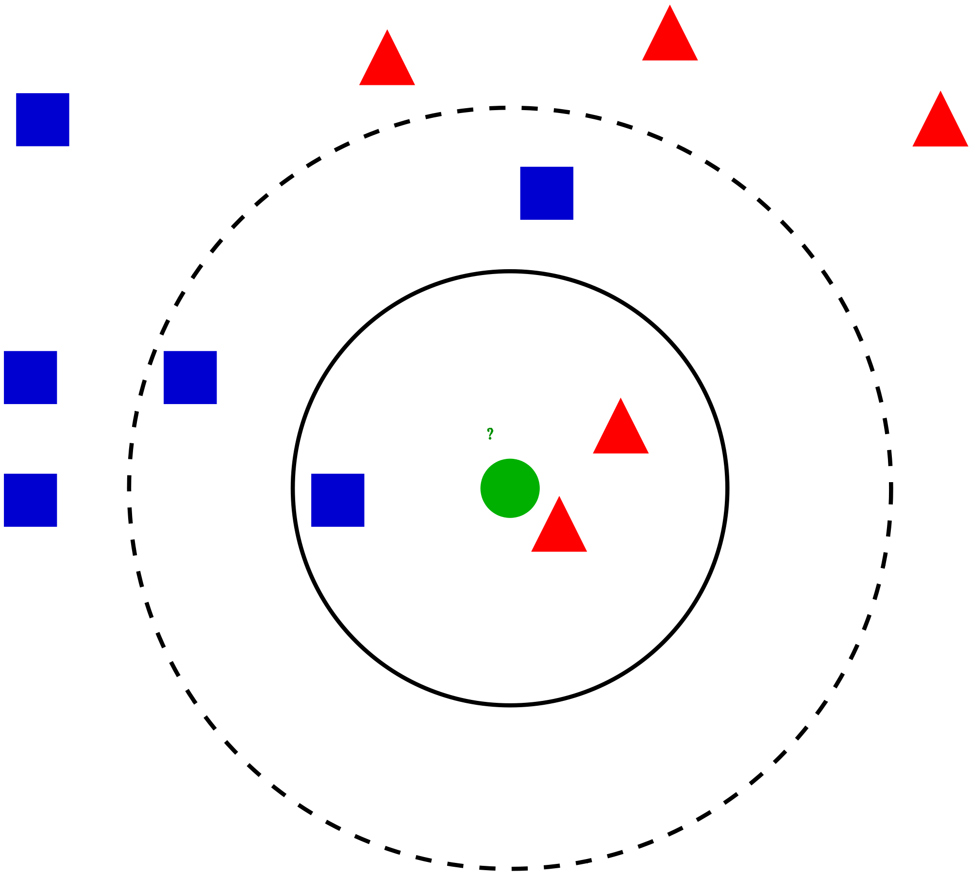
K-Nearest Neighbours(kNN)
Supervised Machine learning
Easy to implement
For both classification and regression problems
Notes:
https://www.analyticsvidhya.com/blog/2018/03/introduction-k-neighbours-algorithm-clustering/ image
Moving on to K-nearest neighbours.
The k-nearest neighbors (KNN) algorithm is a simple, easy-to-implement supervised machine learning algorithm that can be used to solve both classification and regression problems.
The KNN algorithm assumes that similar things exist in close proximity. In other words, similar things are near to each other.

Slide 24
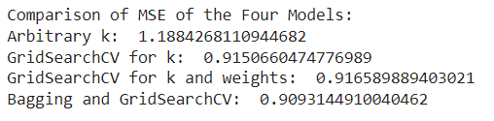

K-Nearest Neighbours(kNN) with Bagging
Bagging-an ensemble method
Notes:
After using KFold, our group also introduce another new method which is known as bagging.
Bagging is an ensemble method, or a method that takes a relatively straightforward machine learning model and fits a large number of those models with slight variations in each fit. Ensemble methods are often more performant than single models. One model can be wrong from time to time, but the average of a hundred models should be wrong less often. The errors of different individual models are likely to average each other out, and the resulting prediction will be less variable.
As seen from the image, bagging reduce the Mean squared error to 0.90931 which is the lowest among the four models.
Finally, our group managed to obtain a MAE of 18.304 on the test data.

Slide 25
Conclusion
Outcome
We are able to predict the total number of cases with the environmental and climate data to a certain extent
With SVM being the best model as it had the lowest MAE among the 3 models
Notes:
From the mini project, we are able to predict the total number of cases with the environmental and climate data to a certain extent.
With Support vector machine being the best model as it had the lowest mean absolute error among the 3 models

Slide 26
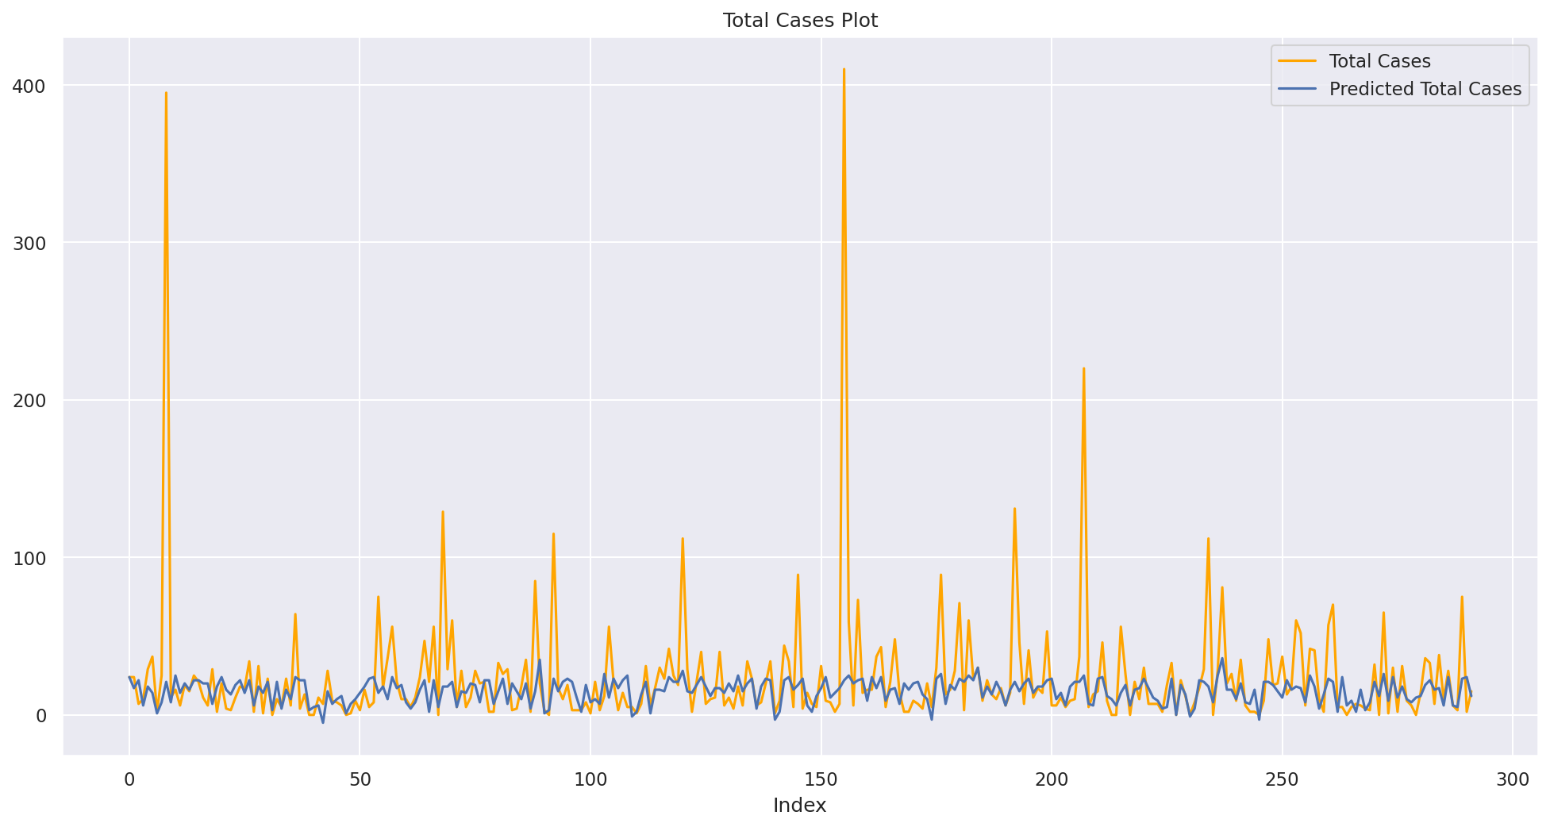
Conclusion
Using SVM,
Notes:
Support vector machine has the lowest Mean Absolute error of 15.9863
By using the support vector machine to plot the graph of total cases and predicted total cases. We can predict the total cases of dengue
As seen from the graph, the predicted total cases are able to matches the trend of the total cases to a certain extent..

Slide 27
Data - Driven Insights
Model
Can explore other models apart from the ones mentioned to find the best model to predict
Results
Variables did not have such an obvious relationship as we expected
Possible to find more data that could help improve the accuracy of prediction
Notes:
Ultimately, the project has lead us to a few driven insights.
In terms of the model, we can potentially explore other models apart from the ones mentioned to find the best model to predict. One example would be the neural network.
For the results of the project, we can see that the Variables did not have such an obvious relationship as we expected, while we initially believe that most variables such has humidity would have a strong linear relationship. But they are actually not as strongly related as we expect.
Another insight would be to find more data that could help improve the accuracy of prediction. We could use data such as the number of preys of mosquito that could potentially affect the number of dengue cases.

Slide 28
Thank You!
Notes:
This is the end of our presentation, Thank you!

